Slide 1
General Assembly Meeting
10h - 12h
21 October 2014
ASBL: 874.358.592 | | Square du Vieux Tilleul 1/4, 1050 Ixelles, Belgium

Slide 2
Agenda
Welcome by Jimmie Bradshaw
Welcome and Farewells to Members
VOTES:
Approval of minutes from the GM on 7 October 2014
Vice-President & Guest Access by Beckie Metelko
Treasurer Update by Alessandra Bertozzi
Website Update Ludmila Nováková
Membership by Trine Lauvsnes
Bazaar Update by Emily Michnay
Coffee Break (15 minutes)
Restaurant Update by Christina Arvanitaki
Tombola Update by Carla Bucalossi Quatrini
Sponsorship & Event Update by Dionysia Leolei
Any other Business and Closing by Jimmie Bradshaw

Slide 3
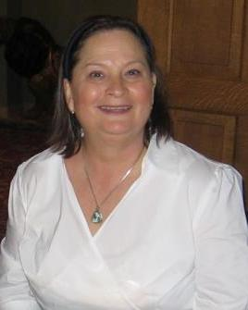
Welcome Jimmie Bradshaw - President president@natocharitybazaar.org

Slide 4
Welcome to Members Jimmie Bradshaw - President
France – Natalie de Coriolis
Lithuania – Snieguole Zenkevicius
Romania – Mihaela Savu

Slide 5
Farewell to Members Jimmie Bradshaw - President
No Farewells today ☺

Slide 6
VOTES Jimmie Bradshaw - President
Approval of: - Minutes from 7 October 2014

Slide 7
Invitations & Lists Beckie Metelko guest-coordinator@natocharitybazaar.org

Slide 8
Invitations & Passes Beckie Metelko guest-coordinator@natocharitybazaar.org
Visitor Lists
VIP – due Nov 4
Guest – due Oct 31
Additional Passes
Helpers – due Oct 31
Musicians – due Nov 4
Deliveries – due Nov 4
Invitations distributed today & at 6 Nov. Meeting.
Lists are available online in Members Only area

Slide 9
Invitations & Lists Guest Coordinator - Beckie Metelko
Fill out forms completely
Include drivers for VIP passes
All persons 12 and above without Family Card seeking access MUST have a pass
Please do NOT add rows to the forms – start a new form
Be ready to show a government-issued photo ID at the NATO gate

Slide 10
Guest Access – Important Dates
 |  |  |  | Oct 16 | Oct 17 Lists due for Oct 21 pick-up | Oct 18
Oct 19 | Oct 20 | Oct 21 | Oct 22 | Oct 23 | Oct 24 | Oct 25
Oct 26 | Oct 27 | Oct 28 | Oct 29 | Oct 30 | Oct 31 Guest & Helper lists due | Nov 1
Nov 2 | Nov 3 | Nov 4 VIP, Music, Delivery lists due | Nov 5 | Nov 6 | Nov 7 | Nov 8
No access lists accepted after Nov 4

Slide 11
Invitations & Passes Beckie Metelko guest-coordinator@natocharitybazaar.org
Guest and VIP Passes
Only valid on November 16
Helper Passes
Only valid for one day – November 15 OR 16 – YOU specify how many of your allotted passes for each day

Slide 12
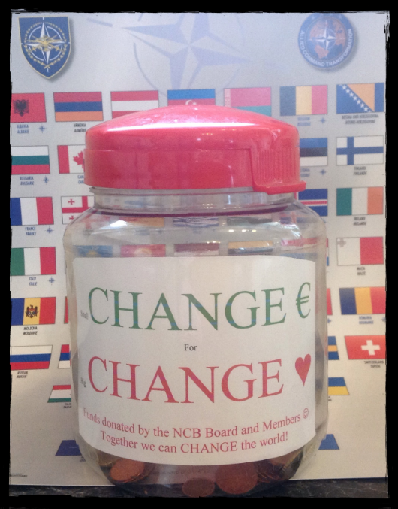
Change Jar Beckie Metelko – Vice-President & Guest Access

Slide 13
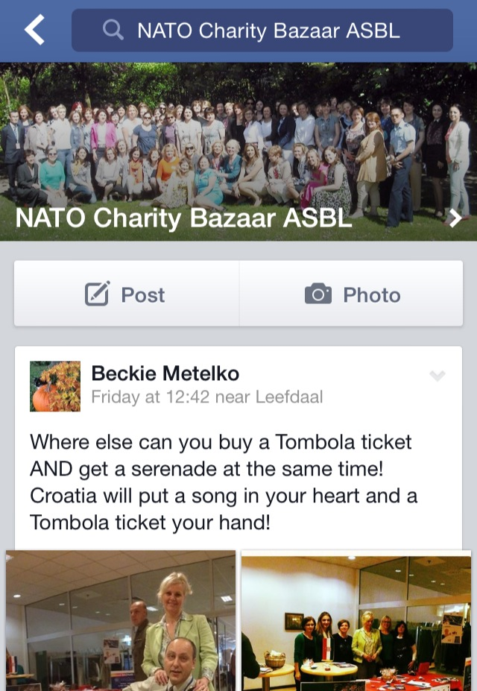
On facebook Beckie Metelko- Administrator
161
Members
If you have requested to join and have not been added:
Check your Facebook messages for a reply from an administrator asking for your connection with the bazaar.
Or see me after the meeting.

Slide 14
Treasurer Update Alessandra Foresti – Treasurer
treasurer@natocharitybazaar.org
Treasurer update
Notes:
14
14
14
14

Slide 15
Treasurer Update Alessandra Foresti - Treasurer
TOTAL INCOME 2014
17.862 EUROS
On 20 October 2014
- Sponsors 10.027 €
- Bake Sales 5.179 €
- Bank premium 17 €
- Small x BIG 194 €
- Fundraising events 2.445 €
Notes:
15
15
15
15
15

Slide 16
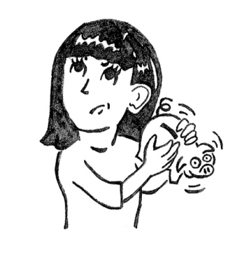
Payment of funds into the NCB account Alessandra Foresti - Treasurer
If you have any questions, please don’t
hesitate to contact the
treasurer, Alessandra, via e-mail at
treasurer@natocharitybazaar.org.
Notes:
16
16
16
16

Slide 17
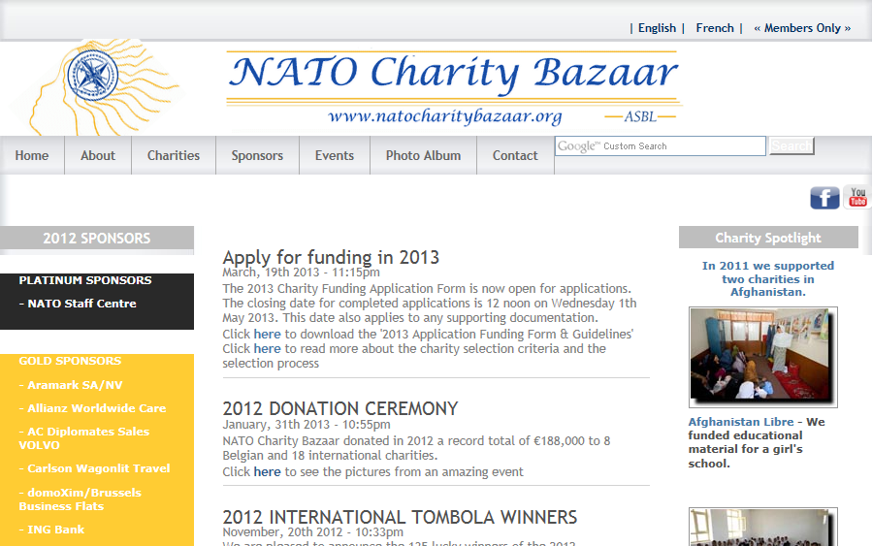
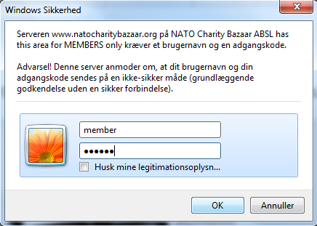
Web Site Access
www.natocharitybazaar.org
User Name: member
Password: member
User Name: members
Password: members
User Name: membre
Password: membre

Slide 18
Membership Database Trine Lauvsnes– Membership Coordinator membership@natocharitybazaar.org

Slide 19
Membership Database Trine Lauvsnes– Membership Coordinator membership@natocharitybazaar.org

Slide 20
Bazaar Update Emily Michnay - Bazaar Coordinator
FINAL 2014 Floor Plan
Bazaar General Instructions
Entertainment
Thank you NATO Staff + Teen Helpers
Bazaar After Sale

Slide 22
NCB Info Table

Slide 23
Saturday 9:00-11:00 Handing in of Tombola Prizes

Slide 24
Saturday
11:00h Opening Ceremony rehearsal
Sunday
9:15h Group Photo
9:45h Opening Ceremony

Slide 25
General Bazaar Instructions Emily Michnay, Bazaar Coordinator emilymichnay@gmail.com
General Bazaar Instructions can be found on the website this week
No tape on paint

Slide 26
Sign on Poles
Hats NOT hung from ceiling

Slide 27
Posters leaning against wall (not taped)

Slide 28
Shelves for storage and display

Slide 29
Great way to hang garland and other items

Slide 30
Signs hanging from wood, NOT ceiling

Slide 31
Great back-drop

Slide 32
Thanking NATO Staff
#1
For all helping NATO Staff during the Bazaar Weekend
Yellow on Saturday
Purple on Sunday

Slide 33
Thanking NATO Staff
#2
Thank You Gift
One (1) bottle per nation
DUE: TODAY
Box & Sign-In sheet next to guest pass pick-up

Slide 34
Bazaar After Sale
Sign Up at 6 November meeting
Dates: Nov 24-28 | Monday - Friday
Time: 10h00 - 14h00
Participants: 5 nations per day
Location: Press Hall (ING Bank area)
Each nation gets 2-3 tables
Everyone needs to be self sufficient

Slide 35
Bazaar After Sale Schedule
SIGN UP AT 6 NOVEMBER MEETING

Slide 36
Entertainment 2014
THANK YOU for your assistance in finding entertainment for the NATO Charity Bazaar ☺
UK
Estonia
Latvia
Turkey
Stage Manager: Vedran Vejic
We are still looking for music or dance groups from your country to perform at the bazaar.
Musician Passes valid for Sunday only
Send Vedran an e-mail at:
entertainment@natocharitybazaar.org

Slide 37
Coffee Break 15 min
Thank you

Slide 38
Sponsors & Events Dionysia Leolei, Sponsors & Event Coordinator
SPONSORS 2014

Slide 39
Sponsors & Events Dionysia Leolei, Sponsors & Event Coordinator
CONFIRMED SPONSORS 2014
Services / Products: Beer from Belgium with love! Next time you see a bottle of Stella Artois, take note of the rich history paired with the rich flavor on and in every bottle
Website: http://www.stellaartois.com/
Meet STELLA ARTOIS at the Bazaar

Slide 40
Sponsors & Events Dionysia Leolei, Sponsors & Event Coordinator
CONFIRMED SPONSORS 2014
Services / Products:
Weibel Scientific is the global leader in the market for advanced Doppler radar systems. Weibel radars are used to protect lives on the ground, in flight, and in space.
Website: http://www.weibel.dk/

Slide 41
Tombola Carla Bucalossi Quatrini tombola@natocharitybazaar.org
Update

Slide 42
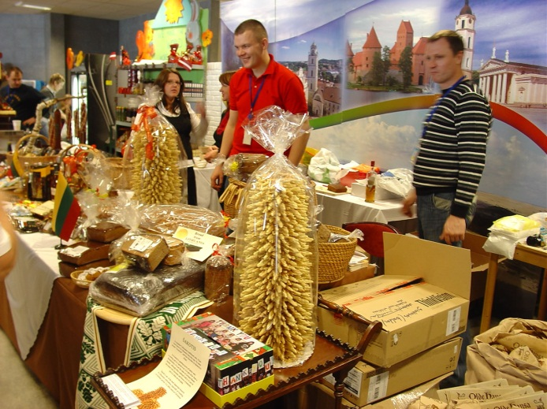
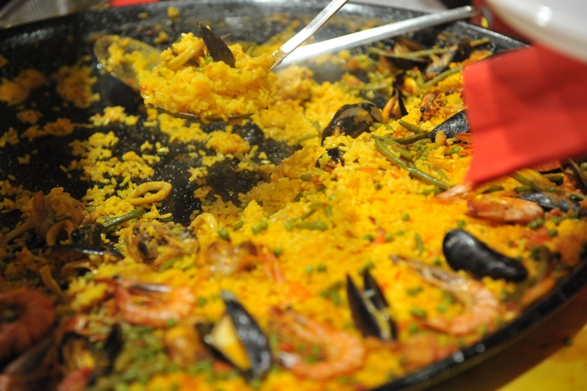
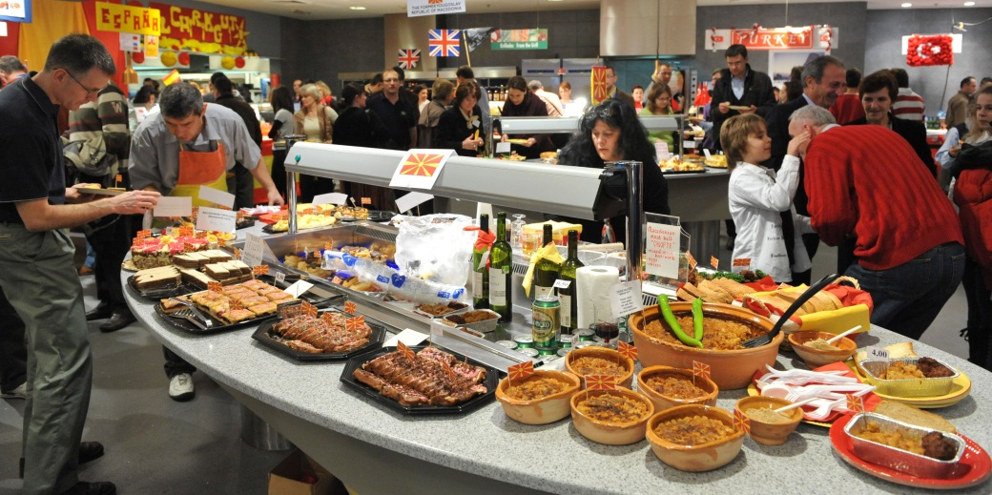
International Restaurant 2014 Christina Arvanitaki - Restaurant Coordinator

Slide 43
International Restaurant 2014 Christina Arvanitaki – Int. Restaurant Coordinator
Nations selling on Saturday
Belgium
Croatia
Czech Republic
Denmark
Estonia
Germany
Greece
Italy
Latvia
Lithuania
The Netherlands
Portugal
Slovakia
Turkey
United Kingdom

Slide 44
GARBAGE MANAGEMENT
CLEAN UP:
We are responsible of the garbage bins closest to our stands.
Empty yellow inside garbage pails hourly, replace the white bag with the new one.
Put garbage in appropriate bins behind kitchen.

Slide 45
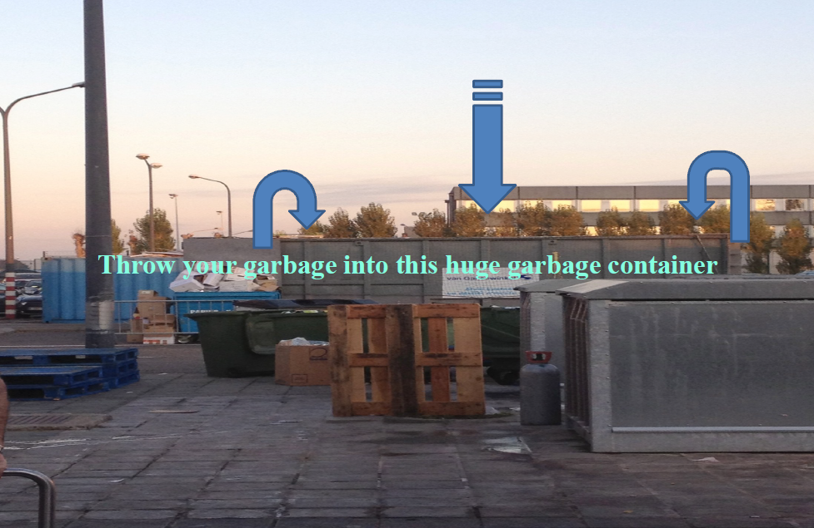

Slide 46
Thanking Teen Helpers
#1
For all Teen Helpers (8-10) during the Bazaar Weekend
Yellow on Saturday
Purple on Sunday

Slide 47
Thanking Teen Helpers
#2
Certificate of Appreciation
Signed by:
the President & the International Restaurant Coordinator

Slide 48
CHILDREN IN THE KITCHEN AREA
For safety reasons children under the age of sixteen (16) years are NOT allowed in the kitchen area!
NO EXCEPTIONS !

Slide 49
FINAL INTERNATIONAL RESTAURANT
COORDINATION MEETING
13 November 2014 at 1500h in NATO Self Service Restaurant with Chef

Slide 50
Any other Business Jimmie Bradshaw - President
France’s Champagne Sale
Thursday, October 23
1400-1600
Press Hall Area

Slide 51
Any other Business Jimmie Bradshaw - President
2014 Patrons
General Bartels, The Chairman of the NATO Military Committee & Mrs. Inge Vansteenkiste
HE Ambassador Alexander Vershbow, The NATO Deputy Secretary General & Mrs. Lisa Vershbow
Air Marshal Sir Christopher Harper, Director General of International Military Staff & NATO Charity Bazaar Honorary President Lady Jan Harper
NATO Charity Bazaar Honorary Vice-President Ms. Kati Schmidt

Slide 52
Patrons & Sponsors Coffee
Thank you to Hungary & Azerbaijan for hosting!

Slide 53
Closing Jimmie Bradshaw - President
Upcoming Meetings
6 November (Last Meeting before Bazaar)
Key Focus: Final Instructions & After sales schedule
13 November
Final Restaurant Meeting with Chef (Kitchen)
27 January 2015
Donation Ceremony - (NATO Staff Centre Banquet Room)
Please return voting cards and folders

Slide 54
Sponsors & Events Dionysia Leolei, Sponsors & Event Coordinator
SPONSORS 2014

